Slide 1


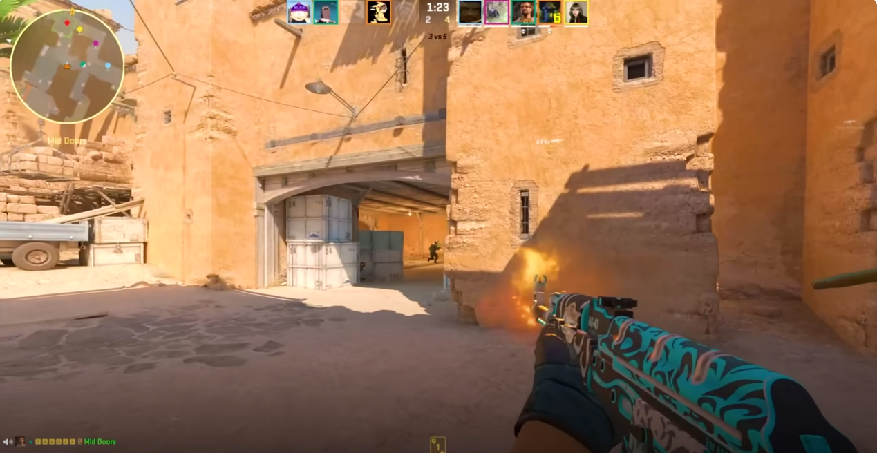
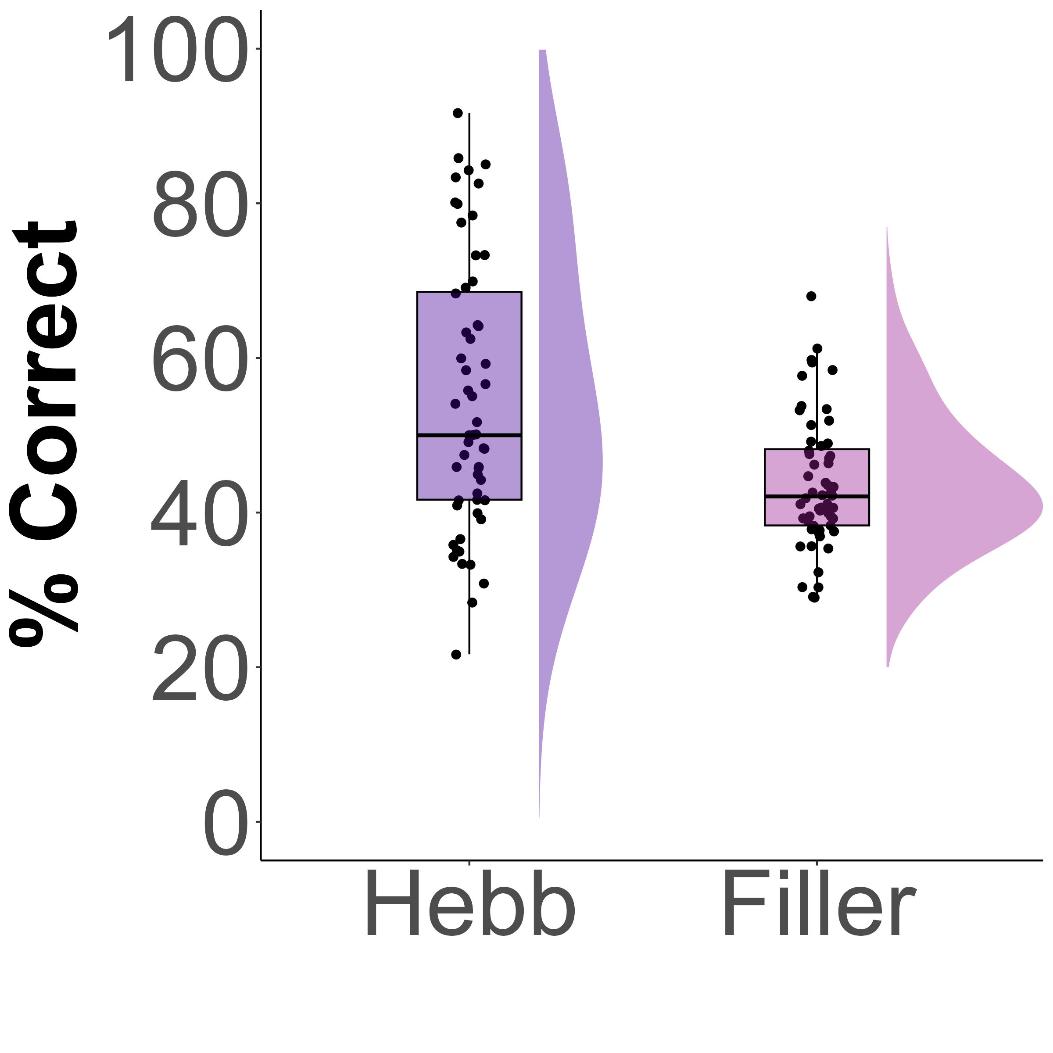
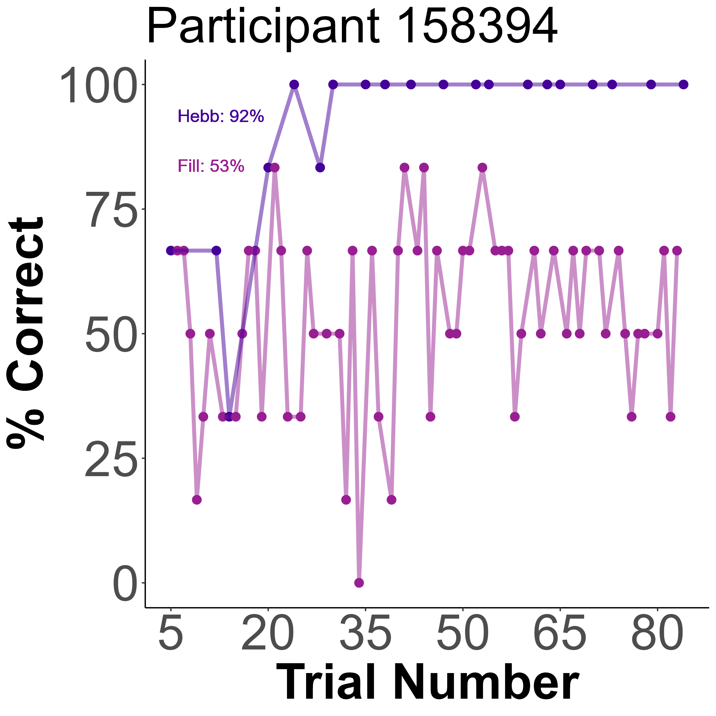
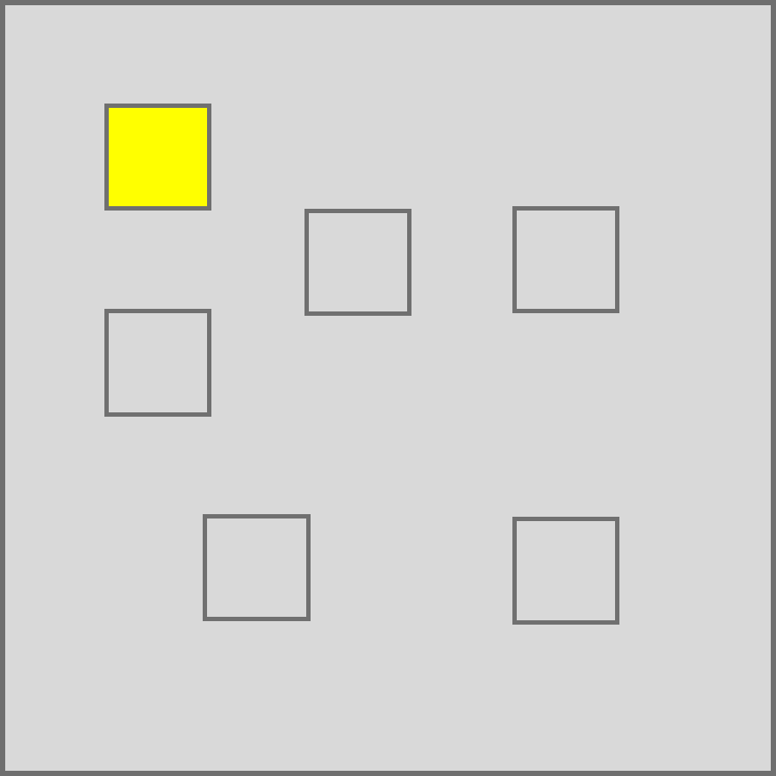
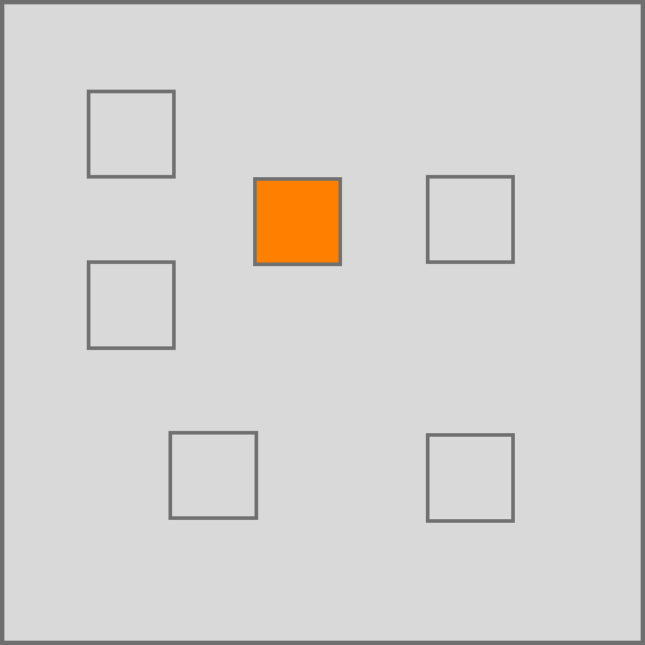
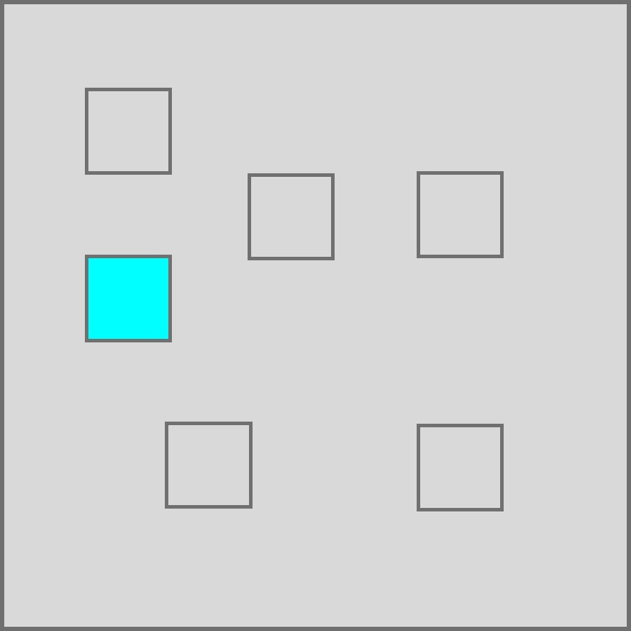
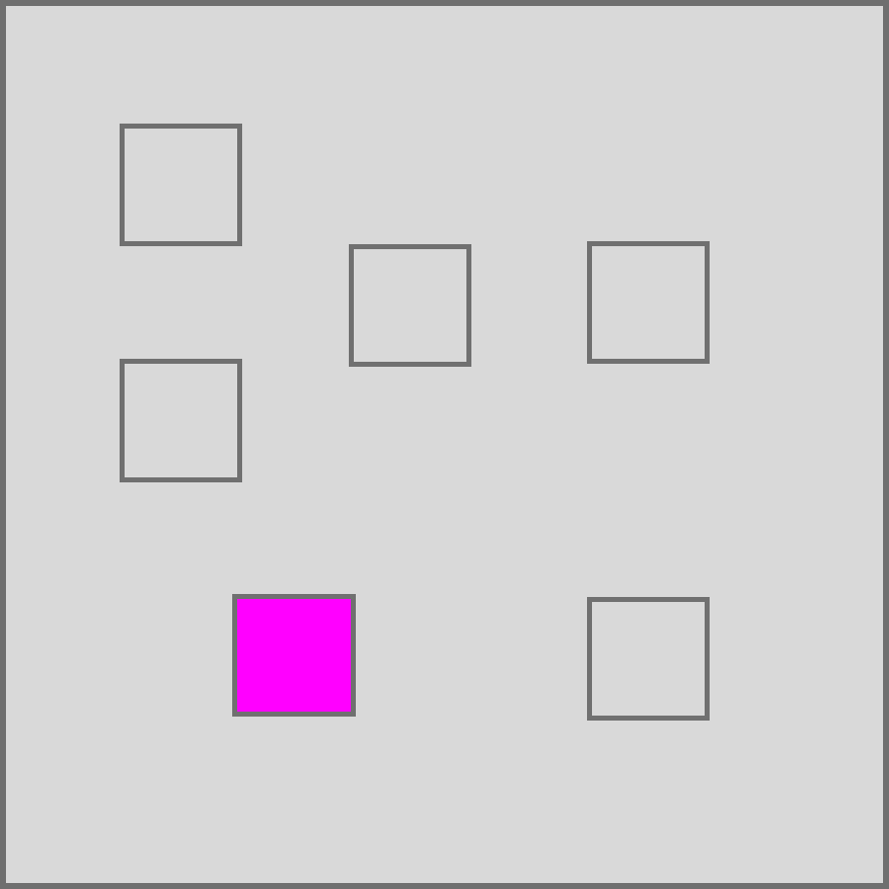
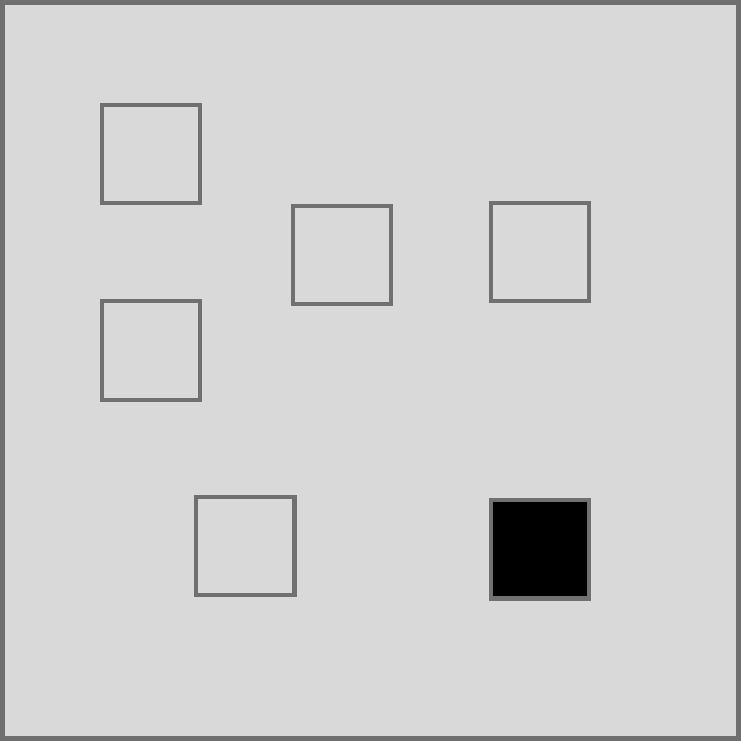
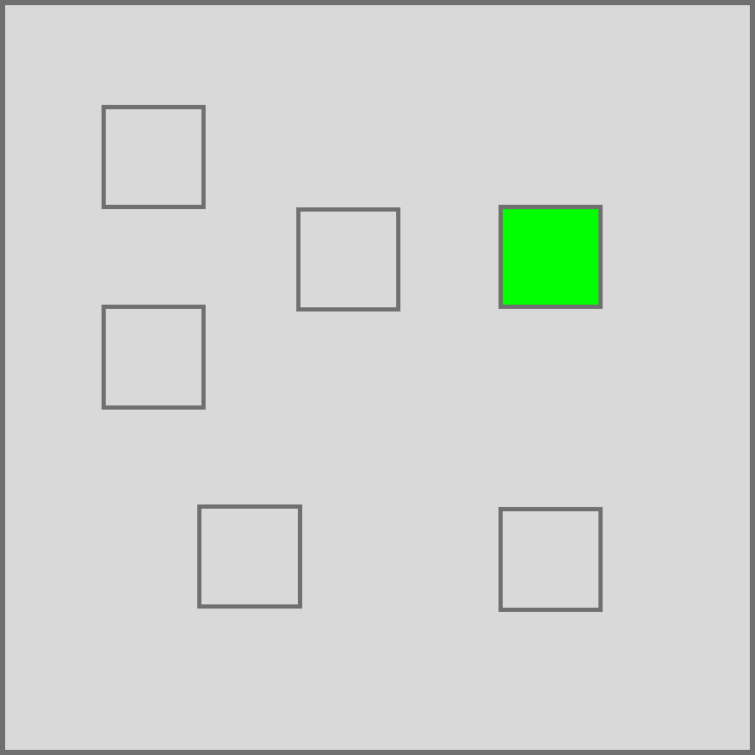

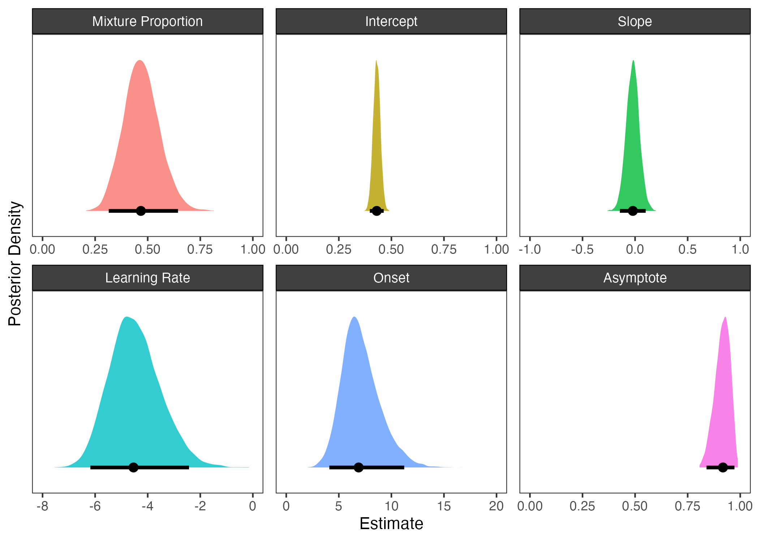
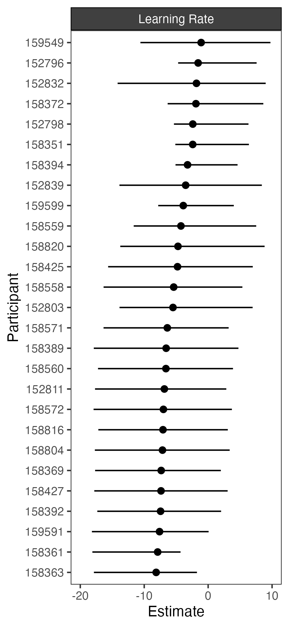
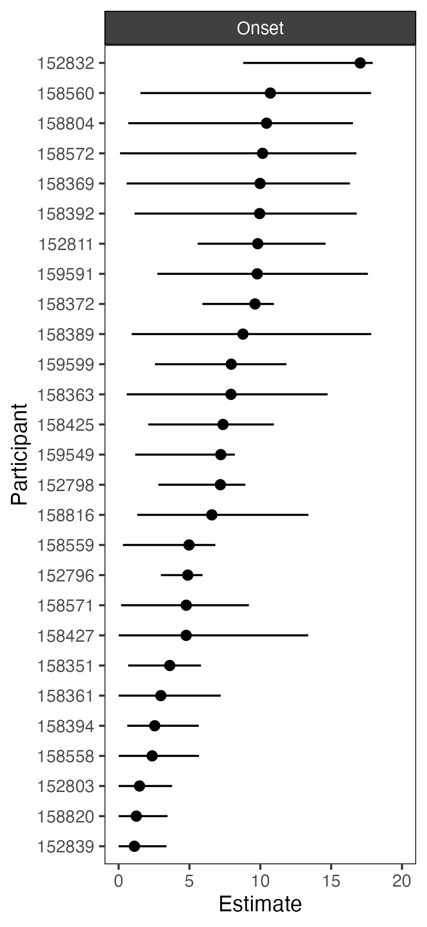
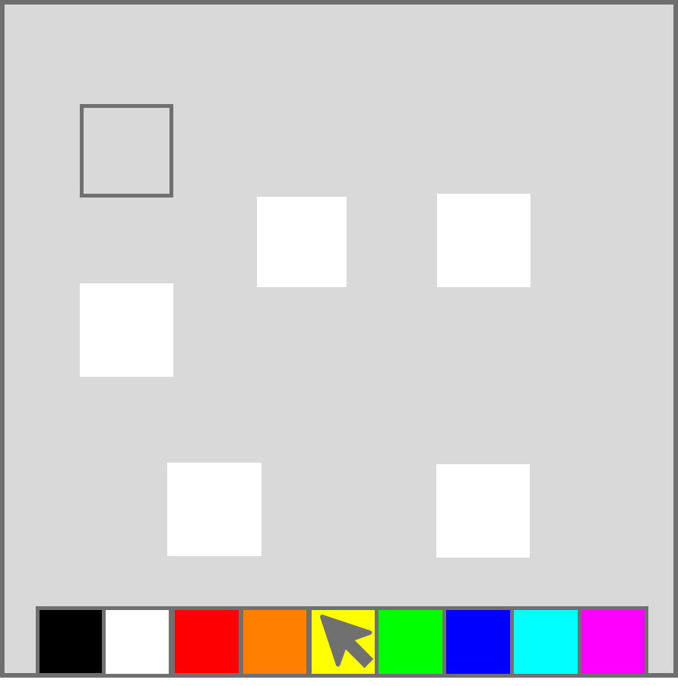
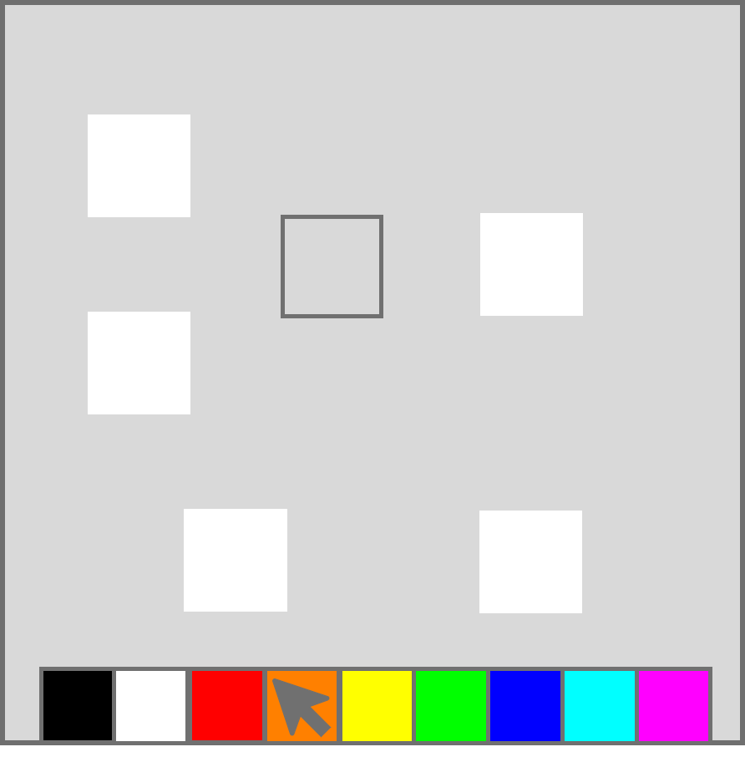
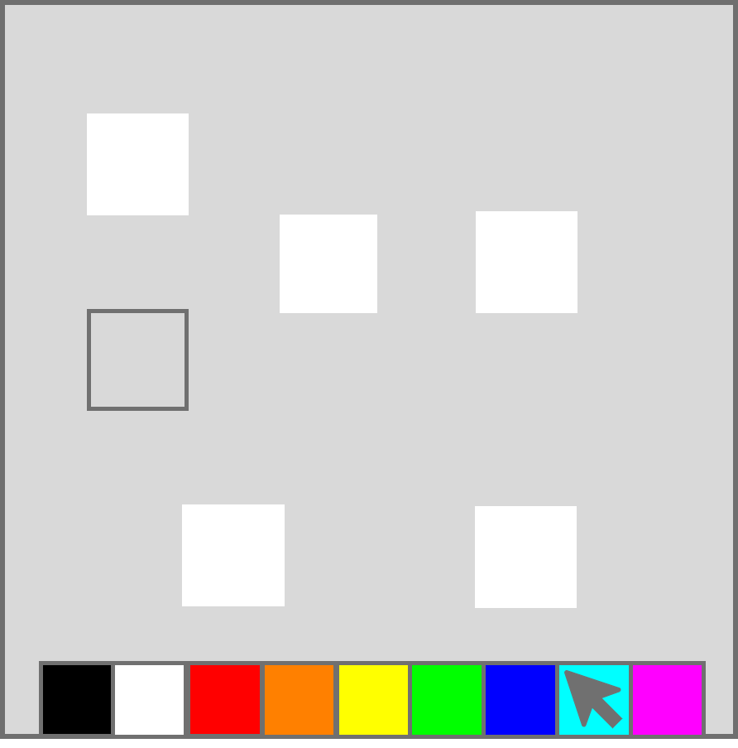
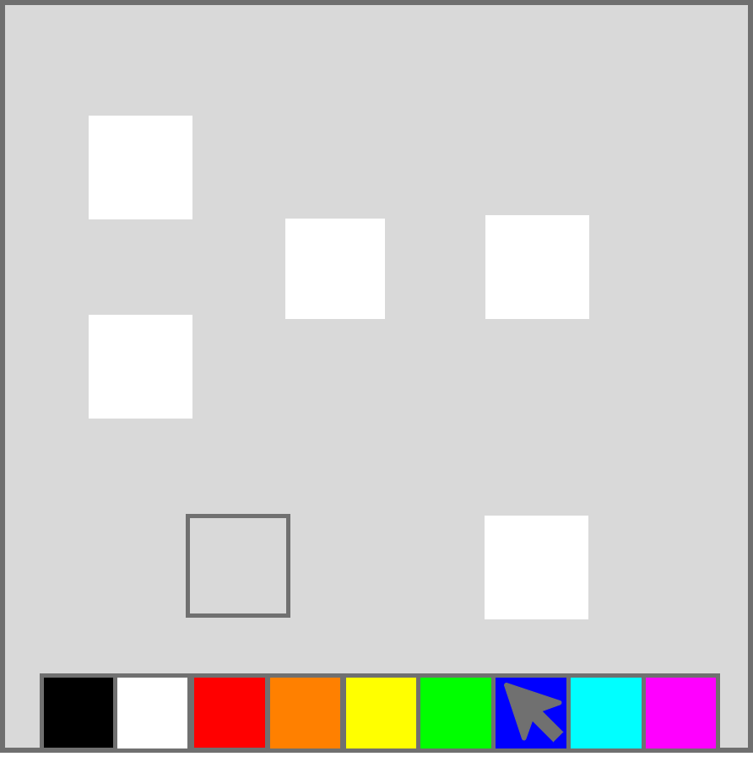
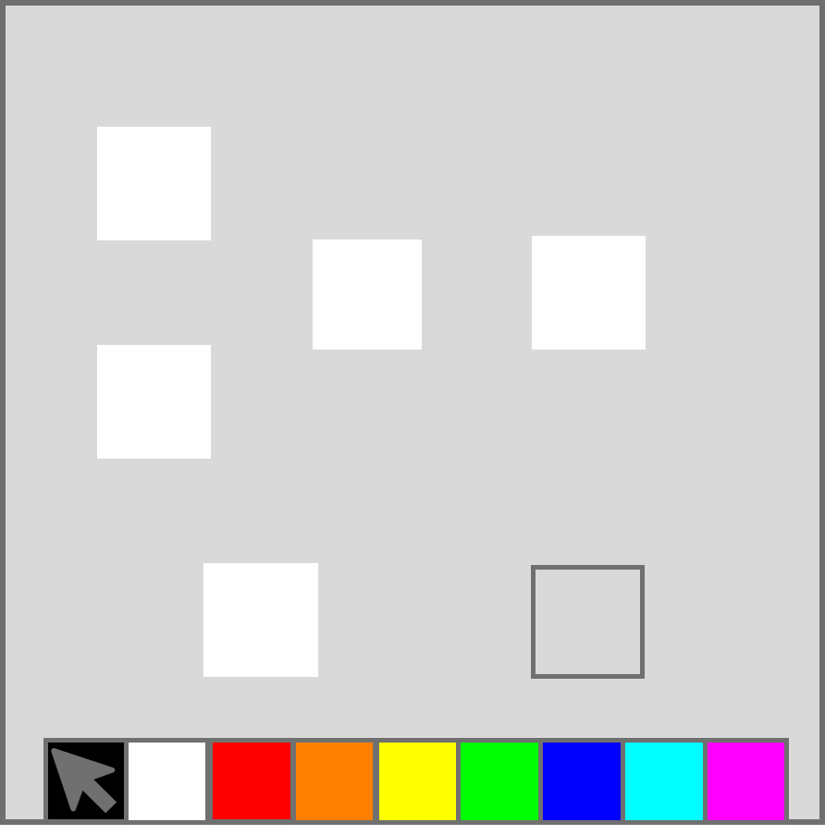
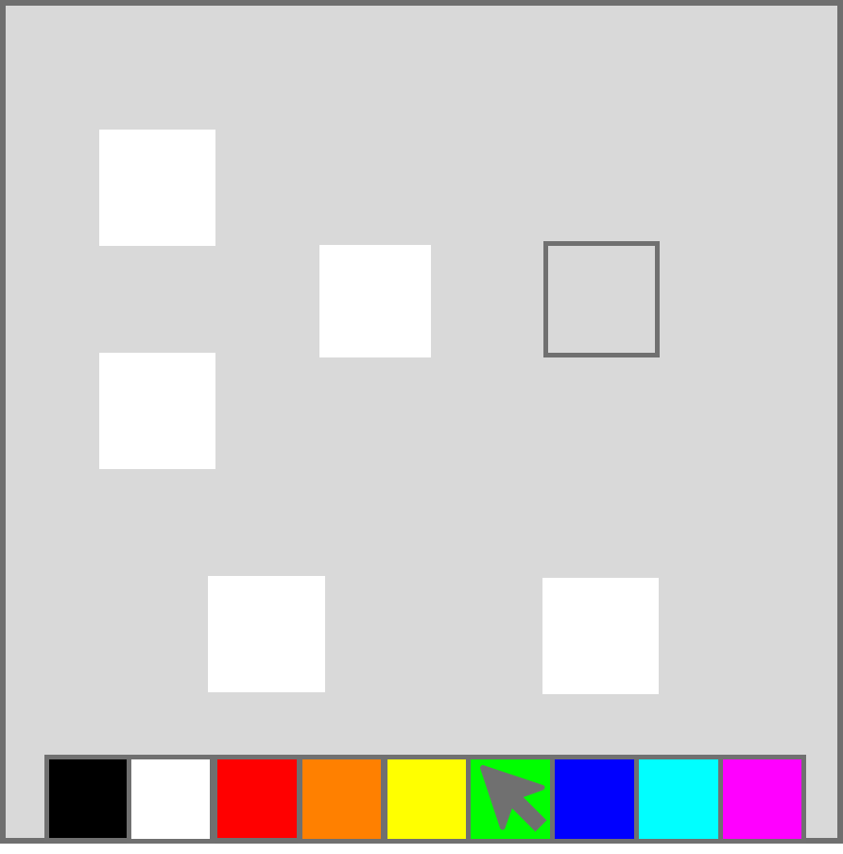
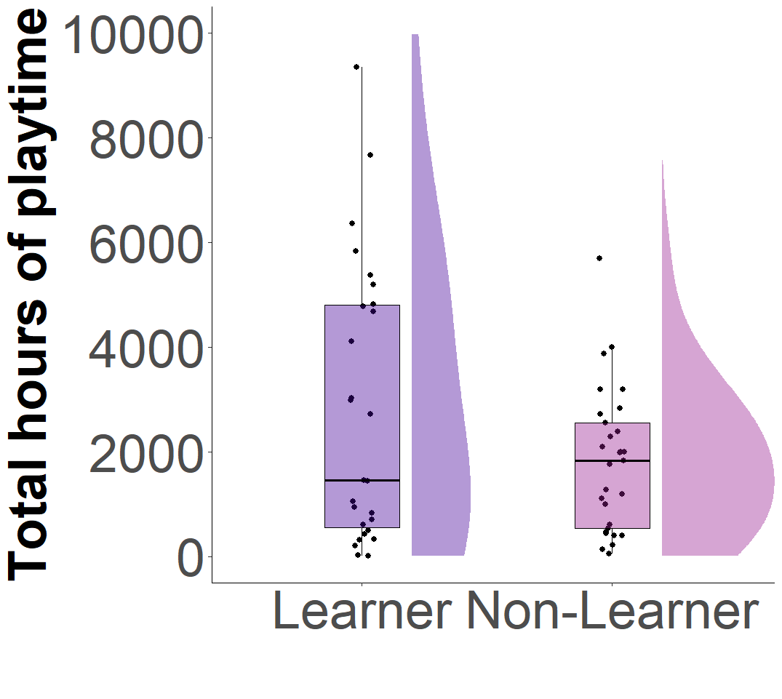

HEBB-REPETITION LEARNING IN PLAYERS OF THE VIDEO GAME COUNTER-STRIKE
Eleanor R. A. Hyde¹, Philipp Musfeld², Robert Schmidt³, Daniel J. Carroll¹, Claudia C. von Bastian¹
¹University of Sheffield, ²University of Zürich, ³Ruhr-Universität Bochum
3126
erahyde1@sheffield.ac.uk
Background
Preliminary Results
Research shows associations between video gameplay and performance across various cognitive domains (Bediou et al., 2018; 2023).
A potential mechanism is ‘Learning to Learn’, where gaming expertise facilitates faster learning on novel tasks (Zhang et al., 2021, Bavelier, et al., 2012).
The Hebb-repetition learning paradigm (Hebb, 1961), which assesses learning through repeated sequence exposure, has not yet been tested in gamers but may reveal enhanced probabilistic inference or pattern recognition, supporting ‘Learning to Learn’.
p < .001, BF = 87.20
Per Participant
Counter-Strike 2 (Valve, 2023)
Hebb: M = 54.81, SD = 17.54
Filler: M = 43.67, SD = 8.46
Method
BAYESIAN HIERARCHICAL MIXTURE MODELLING
Allows estimation of both population-level parameters (describe the sample as a whole) and individual-level parameters (per participant), see Musfeld et al. (2023).
VISUOSPATIAL HEBB-REPETITION TASK (Musfeld et al., 2023)
Unbeknownst to participants, one HEBB sequence is ( on average) repeated every fourth trial, while other FILLER sequences are not repeated.
COUNTER-STRIKE EXPERTISE QUESTIONNAIRE
Total hours of playtime
Fortnightly hours of playtime
Self-rated expertise
Current in-game ranking
PARTICIPANTS
56 Counter-Strike 2 players aged 16-35 years (M = 24.34, SD = 5.04)
Mostly male (50), from the UK (45), and predominantly white (46)
Mostly well educated (M = 16.07, SD = 2.81), and high self-rated socioeconomic status (SES) (M = 5.88, SD = 1.50)
200ms
200ms
200ms
200ms
200ms
200ms
Presentation Phase
Feedback Phase
1500ms
Recall Phase
Participants
p = .086, BF = 1.02
Identified Learners (n = 27) and Non-Learners (n = 29): Mixture Proportion 46.33%.
Estimate
Learning Curve: variable but instantaneous onset point of learning, followed by substantial improvement in learning rate and the upper asymptote, or peak.
COUNTER-STRIKE EXPERTISE
Ambiguous evidence for an association between total hours of playtime and Learner/Non-Learner group status. No other associations found.
Further analysis to understand learning in Counter-Strike players to follow!
References Bediou et al., 2018, Bediou et al., 2023) (Zhang et al., 2021
Bavelier, et al., 2012) Musfeld et al., 2023)
Notes:
Video games provide a valuable ‘sandbox’ for studying cognition in dynamic, immersive and fast-paced settings

